Slide 1
Rendering translucent materials using SSS
Implemented by
João Pedro Jorge &
Willem Frishert

Slide 2
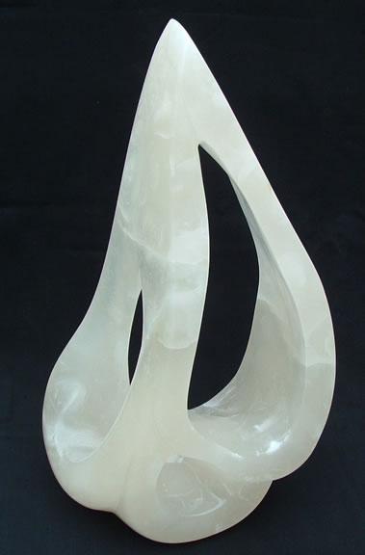
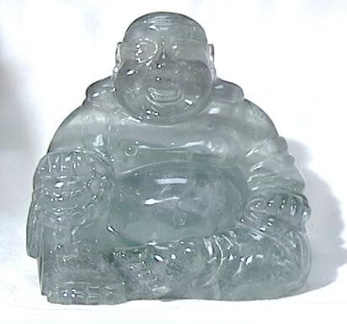
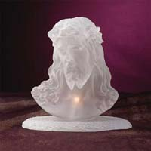
Introduction
Translucent objects
  Light scattering through the object due to material properties

Slide 3
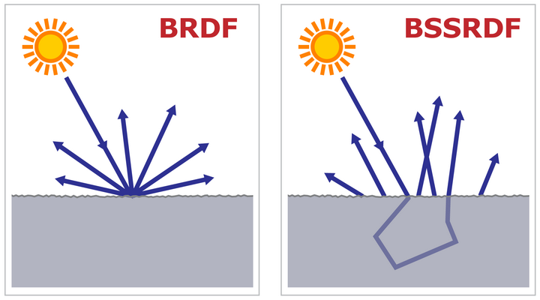

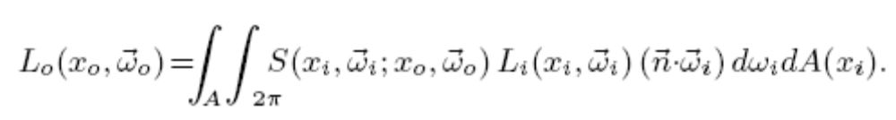
BSSRDF vs BRDF
BRDF approximation of BSSRDF
  Light enters and leaves at the same point

Slide 4
BSSRDF
Heavy computation due to integration
Proposed approximation
  A Rapid Hierarchical Rendering Technique for Translucent Materials – Jensen et al.
  Based on A Practical Model for Subsurface Light Transport – Jensen et al.

Slide 5
Approach
BSSRDF model:
  Single scattering
  Multiple scattering (dominant)
The Diffusion Approximation
  Multiple scattering inside the object lead to diffuse scattering/blur

Slide 6
Diffusion Approximation
2 pass technique:
  First, computing the irradiance at sample positions on the surface
  Second, evaluate the diffusion approximation using irradiance from first pass

Slide 7
Sampling the irradiance
Spread sample points uniformly across the surface – using Turk’s point repulsion algorithm.
Compute irradiance at these points using basic Monte Carlo estimator
Number of points related to mean free path and total surface area

Slide 8
Turk’s Point Repulsion
Points are seen as particles that repel each other
Solved by relaxation techniques
Compute forces (fold/unfold triangles) between points
  Transformation matrices to make triangles coplanar
Apply forces, moving points across the surface
  Find edge intersections
  Triangle use sets to move points across edges

Slide 9
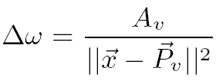
Evaluating Diffuse Approximation
Options:
  Sum the contribution from all the samples
    Computationally expensive since most objects have thousands of samples on the surface
  Hierarchical evaluation
    Store irradiance values on an octree
    Evaluate voxels regarding the maximum solid angle spanned
    Each node stores Ev, Av and Pv

Slide 10
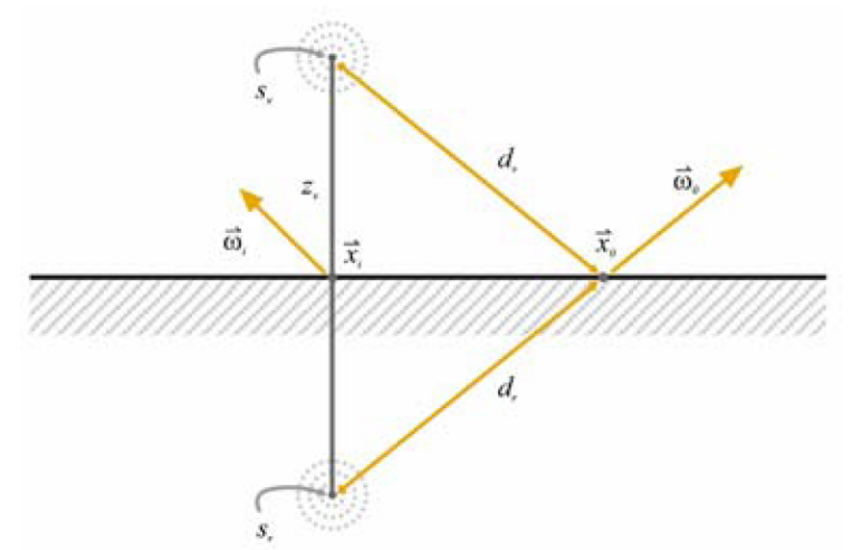
Dipole Diffusion Approximation
A function extracted from medical sciences to calculate how light varies when traveling through a material

Slide 11
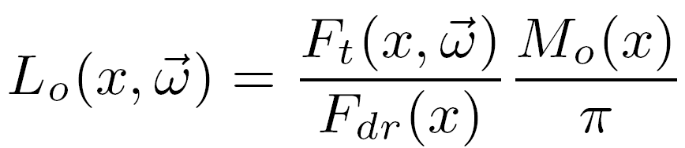
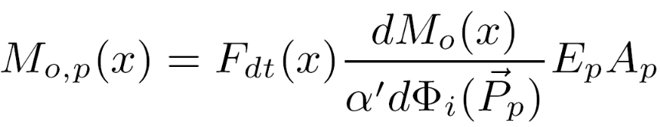
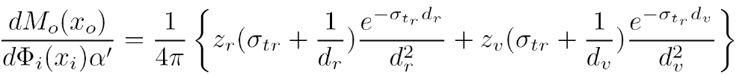

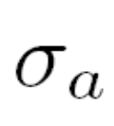
Computing the dipole diffusion approximation
Input values:

Slide 12
Issues
Initial approach:
  Using a Renderman renderer: Pixie
Change to PBRT: Setting it up
Computation of the number of samples on the surface and mean free path
Turk’s algorithm took 50% of the total time
  Floating point precision issues

Slide 13
Conclusions
Turk’s point repulsion
  Problems with large meshes
  Triangle/sample ratio
Empirical vs measured values for:
Amount of work spent: ~200hrs/person

Slide 14
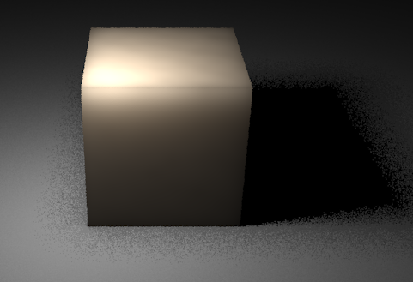
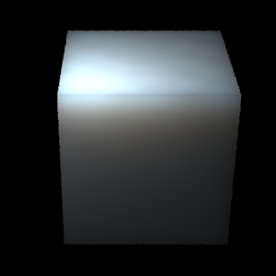
Intermediate Results

Slide 15
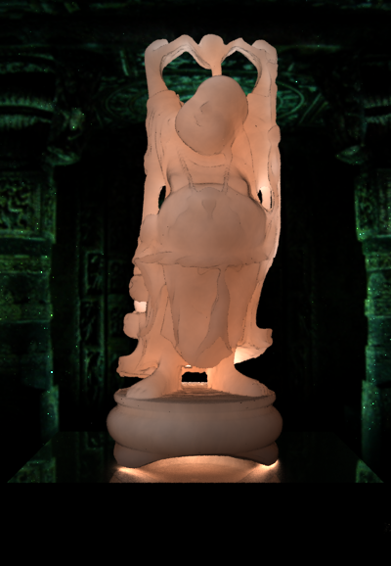
Final Results

Slide 16
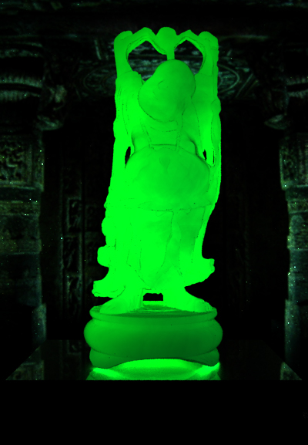
Final Results

Slide 17
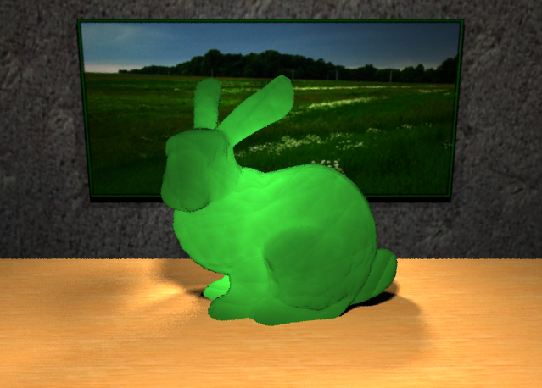
Final Results

